Slide 1

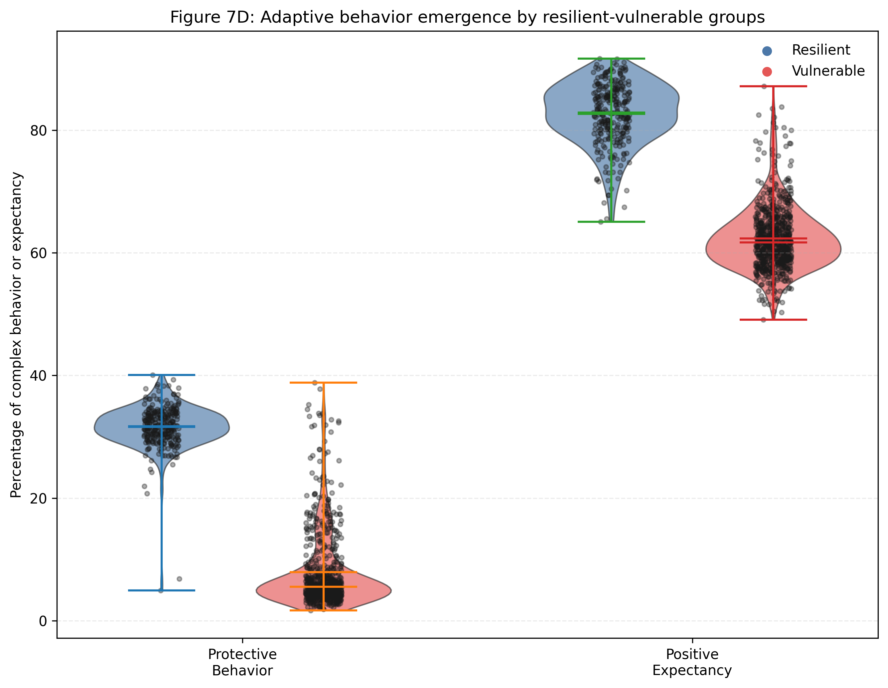
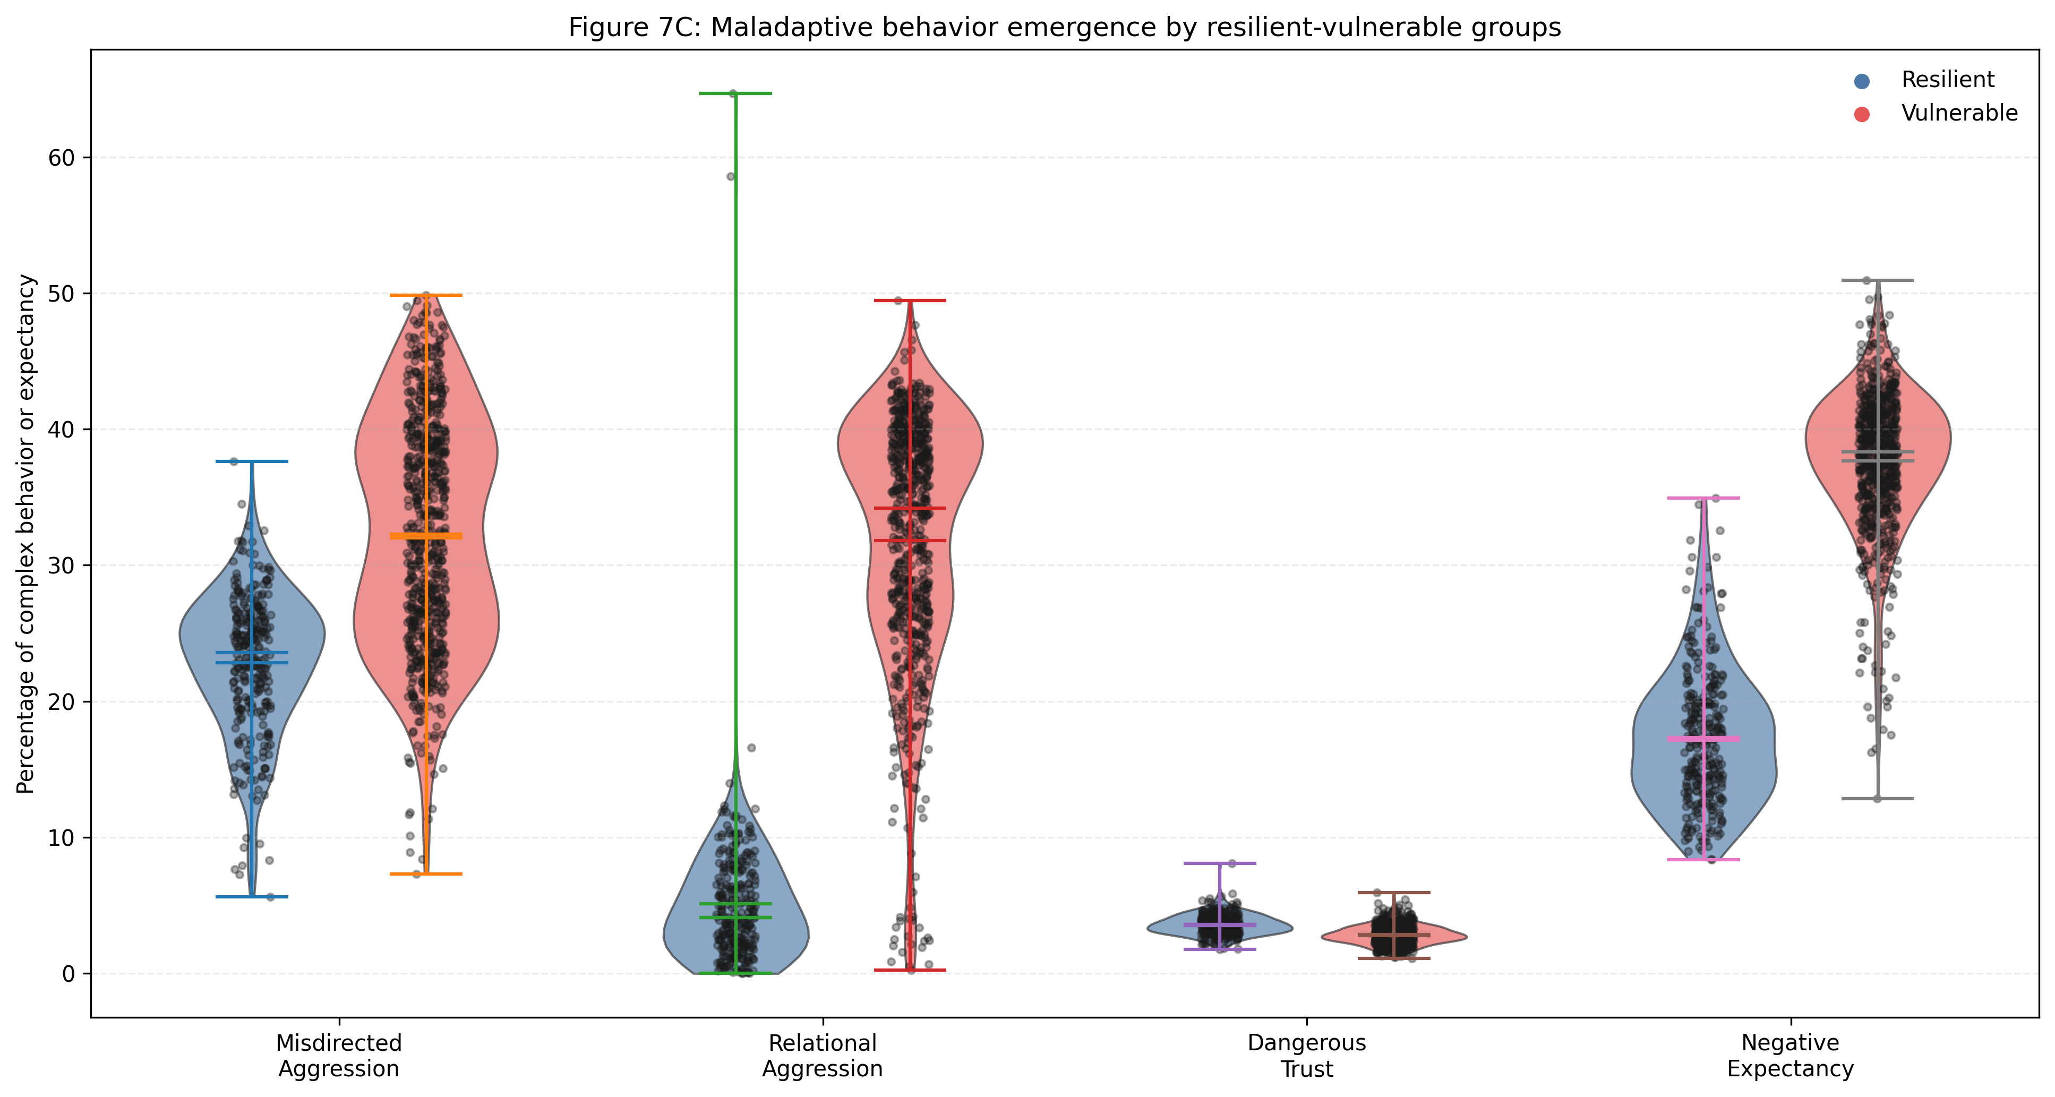
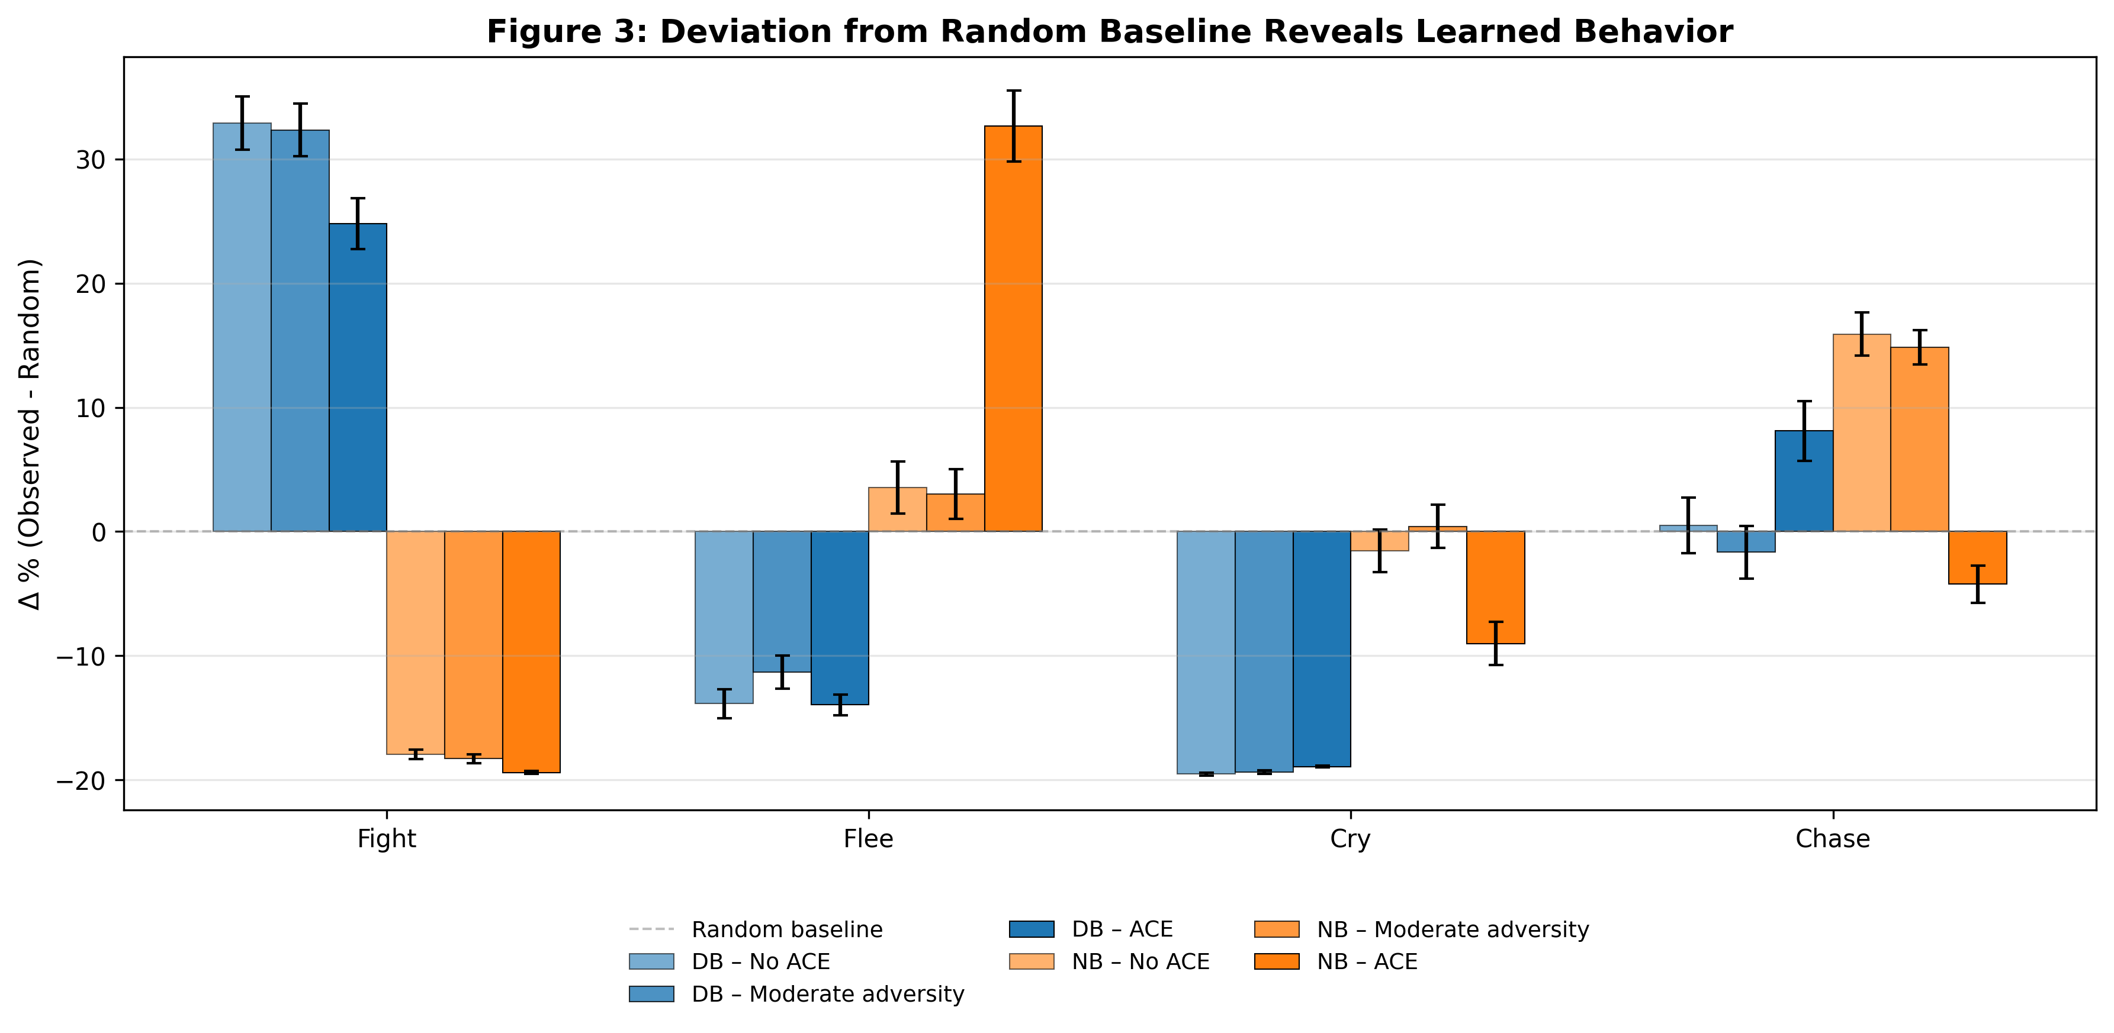
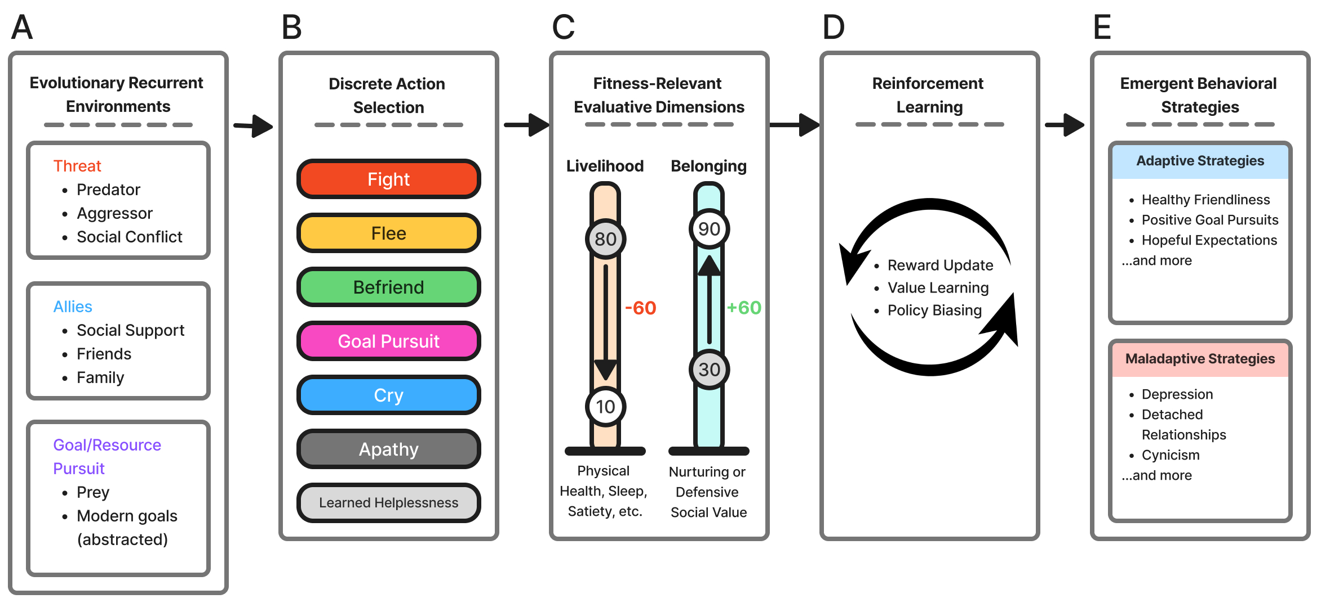
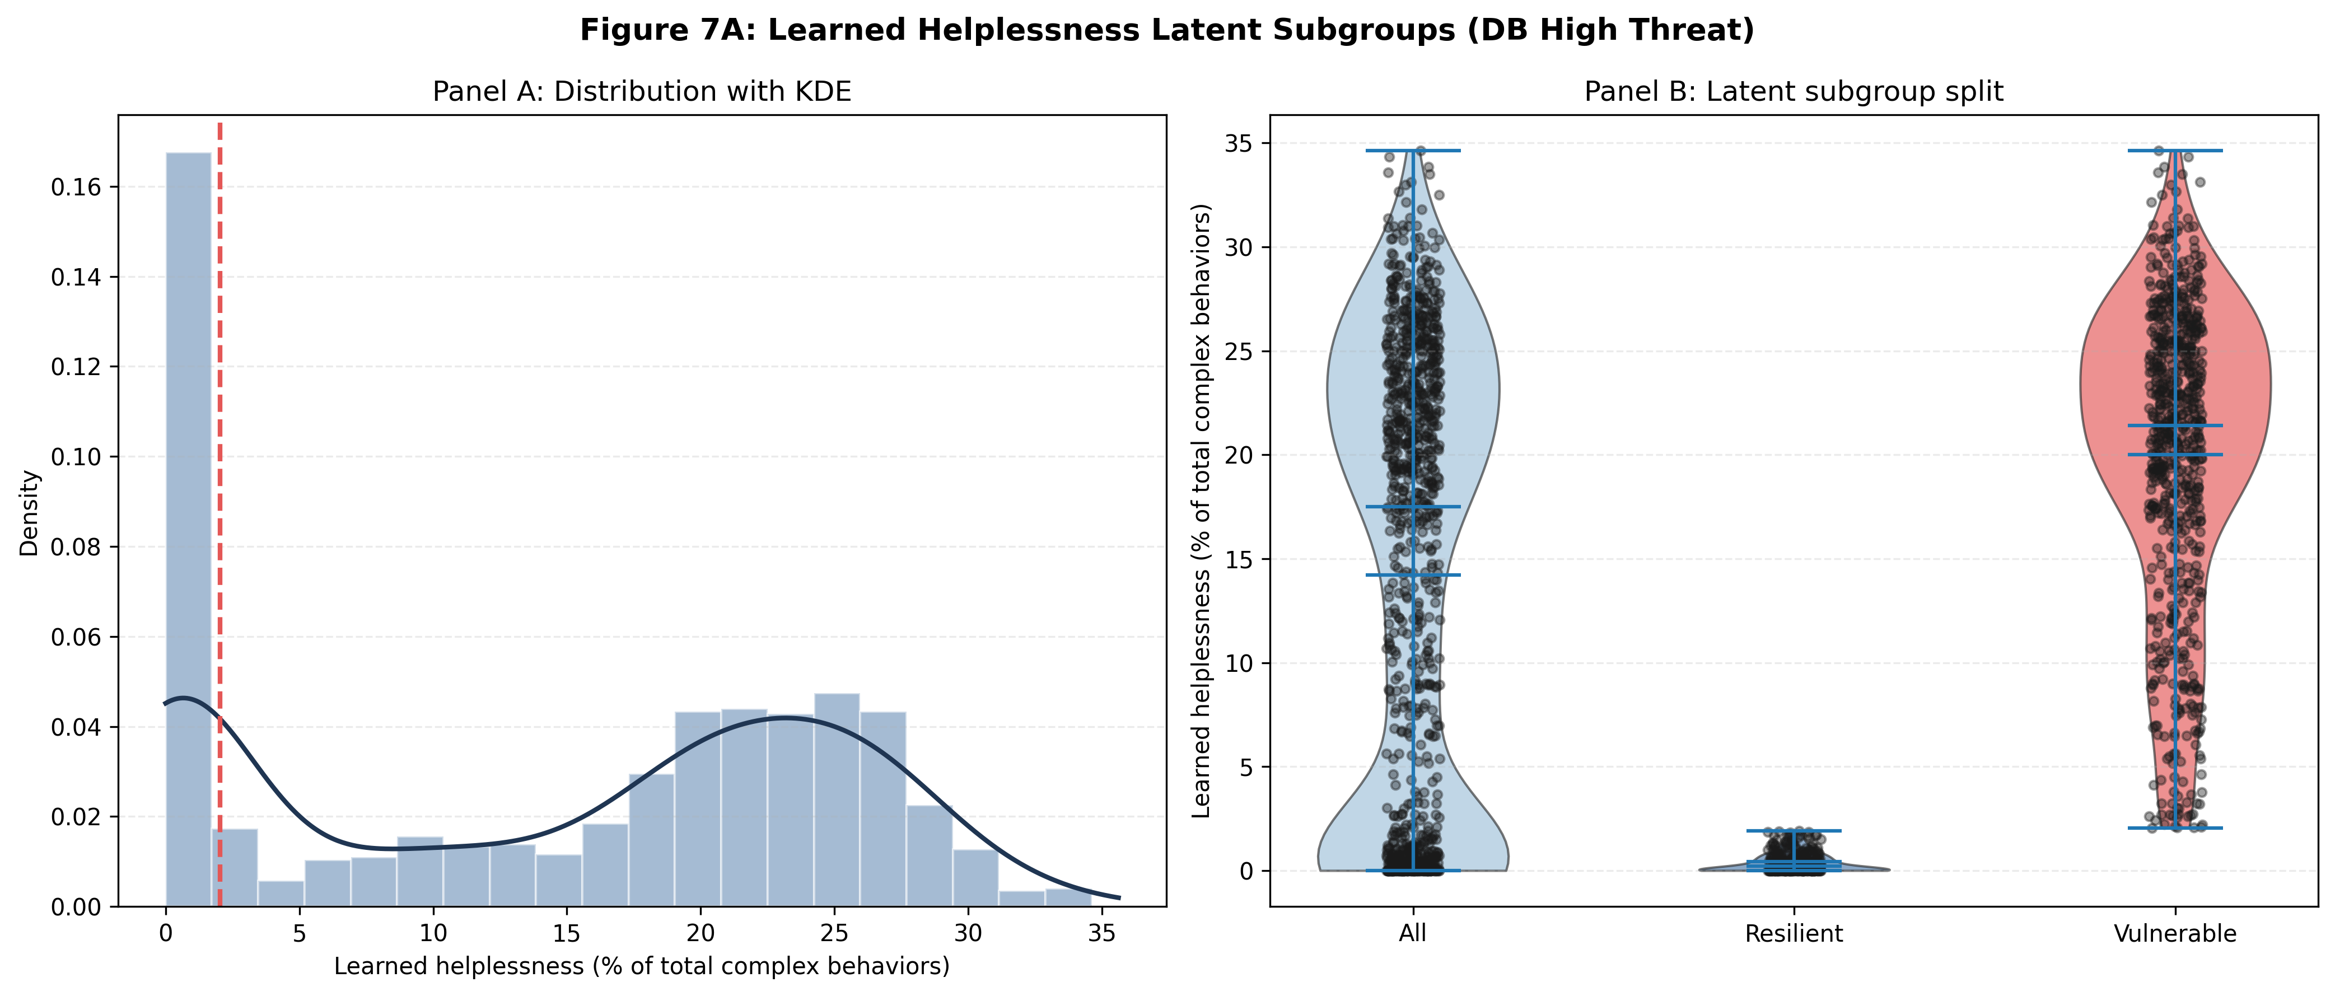
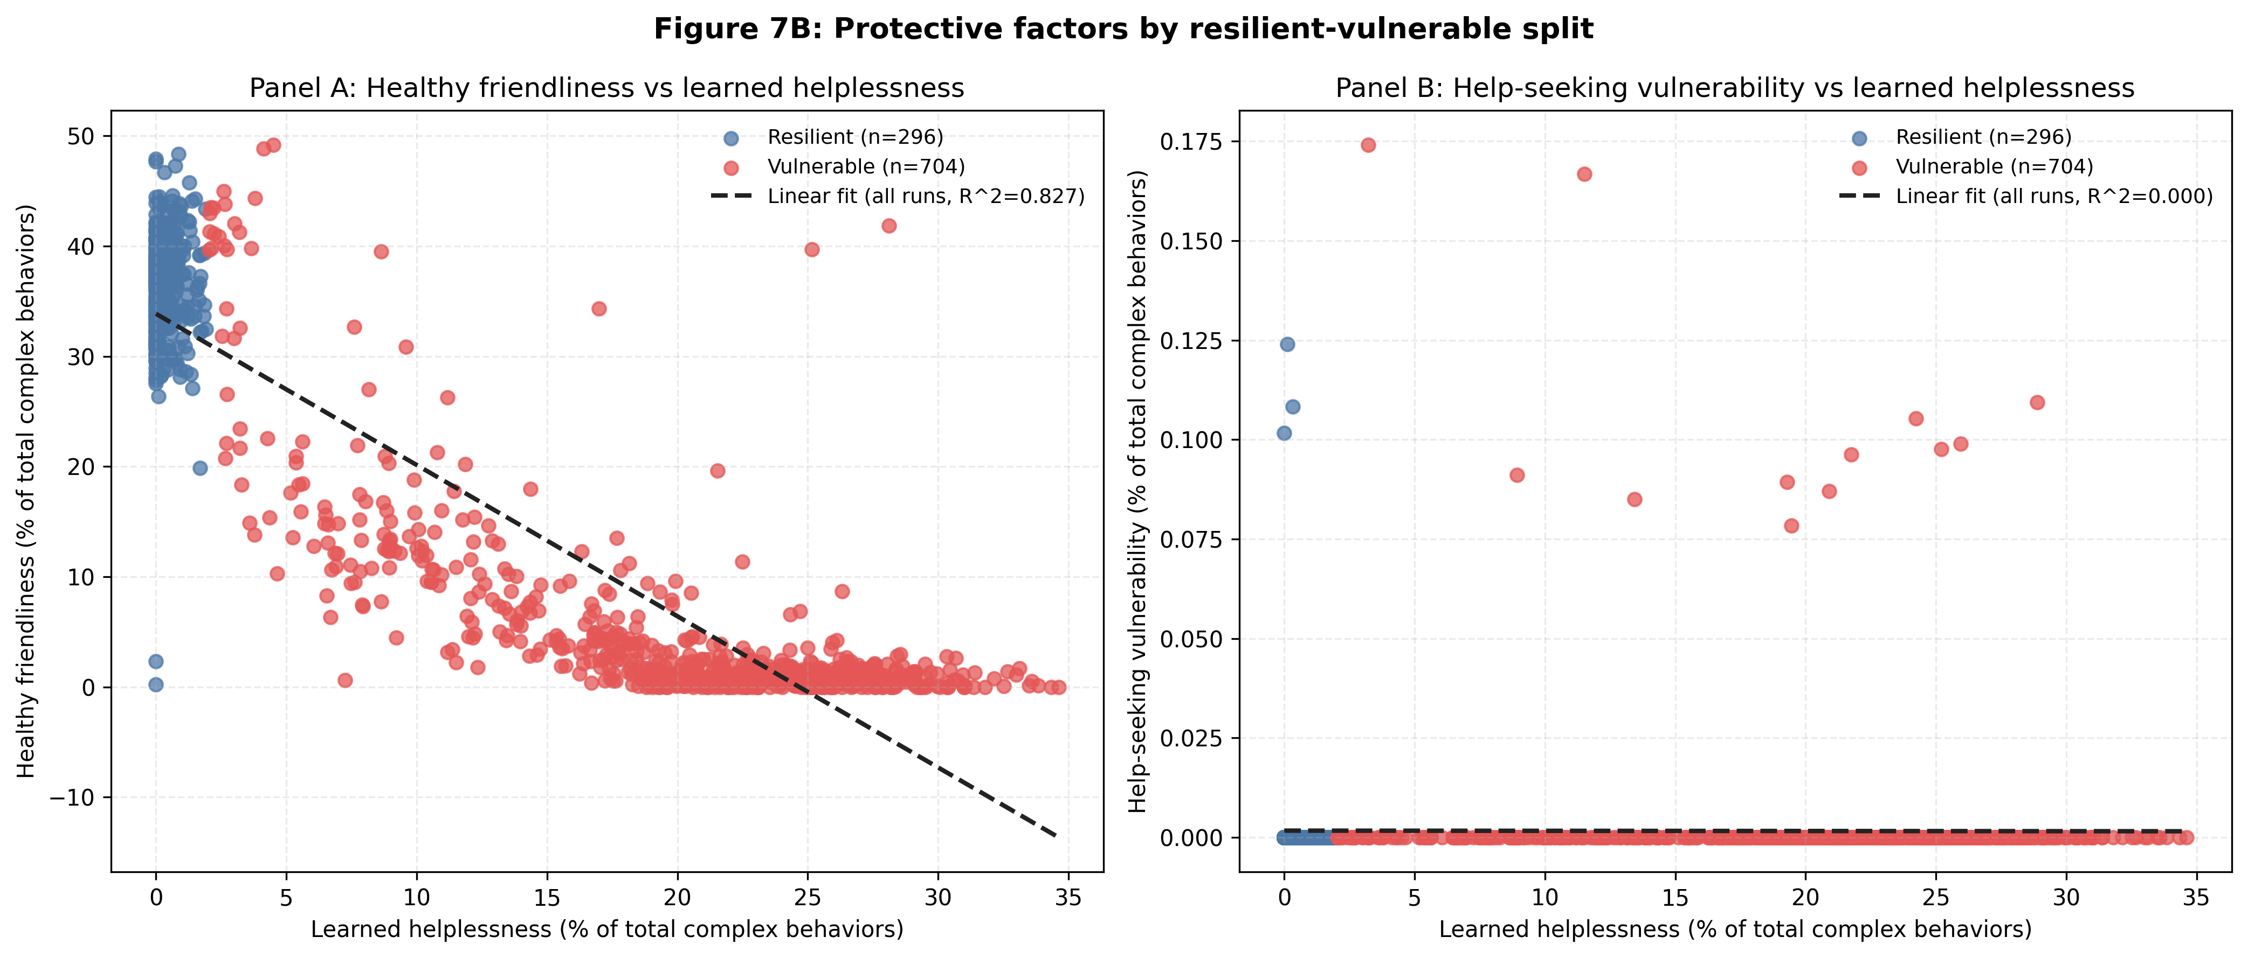
Evolutionary Recurrent Decision Model: Emergence of Behaviors from Evolutionary Recurrent Processes
Andrew Hu (ahu314@gatech.edu) Video Link: https://www.youtube.com/watch?v=9yi2FajlUMk
Introduction
DB-dominant and NB-dominant agents trained on increasing adversity conditions [4]
200 independent runs per conditions, 1500 training steps
Modern mental health disorders like depression, anxiety, and PTSD are rising despite medical and psychological advances.
The brain evolved ~200,000 years ago, but cultural and technological evolution transformed environments much more rapidly [1]
Can a reinforcement learning agent trained on evolutionarily grounded constraints and rewards create adaptive and maladaptive patterns?
Results
Conclusions
Bounded rationality and satisficing from mismatched environments can lead to behavioral regimes [3].
Mechanistic reasoning for why the same adverse conditions produce different outcomes (resilience and vulnerability) with ecological validity
For DB-dominant profiles, a healthy relationship is more protective than help-seeking vulnerability [6]
ERDM offers an ethical computational, unifying framework for studying behaviors difficult to experiment with evolutionarily reasonings [2]
Future directions: perceptual distortion, multi-agent simulations, broader environmental conditions and actions
Figure 1. Bounded rationality and satisficing from mismatched environments to create behavioral regimes [3].
Methods
Citations
ERDM is a single-agent reinforcement learning framework operating across three evolutionarily recurrent environments: threat, prey/goal-pursuit, and alliance opportunities
Uses multiple independent value networks rather than a single scalar reward to reflect competing objectives
Three multi-objective rewards: Livelihood (L), Defensive Belonging (DB), Nurturing Belonging (NB) [4, 5]
1. Bender, A. (2019). The role of culture and evolution for human cognition. Topics in Cognitive Science, 12(4), 1403–1420. 2. https://doi.org/10.1111/tops.12449
2. Bentley, P. J., & Lim, S. L. (2022). From evolutionary ecosystem simulations to computational models of human behavior. WIREs Cognitive Science, 13(6). https://doi.org/10.1002/wcs.1622
3. Brenner, S. L., Jones, J. P., Rutanen-Whaley, R. H., Parker, W., Flinn, M. V., & Muehlenbein, M. P. (2015). Evolutionary mismatch and chronic psychological stress. Journal of Evolutionary Medicine, 3, 1–11. https://doi.org/10.4303/jem/235885
4. Jiménez, Á. V., & Mesoudi, A. (2019). Prestige and Dominance: A Review of the Dual Evolutionary Model of Social Hierarchy. https://doi.org/10.31234/osf.io/sh7mg
5. Rojas, M., Méndez, A., & Watkins-Fassler, K. (2023). The hierarchy of needs empirical examination of Maslow’s theory and lessons for development. World Development, 165, 106185. https://doi.org/10.1016/j.worlddev.2023.106185
6. Sölva, K., Haselgruber, A., & Lueger-Schuster, B. (2023). Resilience in the face of adversity: Classes of positive adaptation in trauma-exposed children and adolescents in residential care. BMC Psychology, 11(1). https://doi.org/10.1186/s40359-023-01049-x
Notes:
A. Single childhood example B. High and Minimal ACE effects on Relationships for Defenders C. High and Minimal ACE effects on Coping Styles for Nurturers D. Comparison of Defenders and Nurturers with High ACE

Slide 2
Week # | Task # | Task Description | Estimated Time (Hours) | Complete (Y/N) | Completed Hours
3 | 1 | Create the template task list | 0.25 | Y | 0.25
3 | 2 | Choose research question | 0.25 | Y | 0.25
3 | 3 | Literature review: evolutionary psychology sources batch 1 | 2 | Y | 2
3 | 4 | Literature review: neuroscience sources batch 2 | 2 | Y | 2
3 | 5 | Literature review: CRUM + integrated theories batch 3 | 2 | Y | 2
4 | 6 | Literature review: synthesis and notes consolidation | 2 | Y | 2
4 | 7 | Study James-Lange theory of emotions and core models | 2 | Y | 2
4 | 8 | Study Maslow hierarchy and adaptive/maladaptive behavior theory | 2 | Y | 2
4 | 9 | Refine research questions (iteration 1) | 2 | Y | 2
4 | 10 | Refine research scope and hypotheses (finalization) | 2 | Y | 2
5 | 11 | Define ERDM architecture (core system design) | 4 | Y | 4
5 | 12 | Define ERDM architecture (component relationships) | 3 | Y | 3
5 | 13 | Define ERDM architecture (formal specification) | 3 | Y | 3
5 | 14 | Define evaluative dimensions (reward structure design) | 3 | Y | 3
5 | 15 | Define evaluative dimensions (final tuning + validation logic) | 3 | Y | 3
6 | 16 | Define discrete actions and behavioral mapping (core set) | 3 | Y | 3
6 | 17 | Define discrete actions and behavioral mapping (complex patterns) | 3 | Y | 3
6 | 18 | Design emotional representation (physiology + CRUM integration part 1) | 2 | Y | 2
6 | 19 | Design emotional representation (CRUM mapping + structure part 2) | 2 | Y | 2
6 | 20 | Design emotional representation (final integration + validation) | 1.5 | Y | 1.5
7 | 21 | Build Python simulation framework (core structure) | 3 | Y | 3
7 | 22 | Build Python simulation framework (architecture wiring) | 2.5 | Y | 2.5
7 | 23 | Build Python simulation framework (base environment setup) | 2.5 | Y | 2.5
7 | 24 | Implement agent decision-making (policy biasing system) | 4 | Y | 4
7 | 25 | Implement agent decision-making (value update mechanisms) | 4 | Y | 4
8 | 26 | Implement environmental simulations (core dynamics) | 3 | Y | 3
8 | 27 | Implement environmental simulations (scenario variation system) | 3 | Y | 3
8 | 28 | Add visualization system (behavior tracking graphs) | 4 | Y | 4
8 | 29 | Add visualization system (performance analytics dashboard) | 4 | Y | 4
8 | 30 | Integration setup + debugging preparation | 0 | Y | 0
9 | 31 | Run simulation: ACE condition experiments batch 1 | 3 | Y | 3
9 | 32 | Run simulation: no-ACE condition experiments batch 2 | 3 | Y | 3
9 | 33 | Analyze outcomes and emergent behavioral patterns (phase 1) | 3 | Y | 3
9 | 34 | Analyze outcomes and emergent behavioral patterns (phase 2) | 3 | Y | 3
9 | 35 | Evaluate emotional representations under conditions | 3 | Y | 3
9 | 36 | Extend CRUM mapping based on results | 3 | Y | 3
10 | 37 | Draft report sections (introduction + background) | 4 | Y | 4
10 | 38 | Draft report sections (methods + model design) | 4 | Y | 4
10 | 39 | Revise report (results + analysis integration) | 4 | Y | 4
10 | 40 | Revise report (discussion + interpretation) | 4 | Y | 4
11 | 41 | Prepare presentation slides (core deck) | 3 | N | 3
11 | 42 | Prepare presentation slides (final refinement) | 3 | N | 3
11 | 43 | Proofreading checklist and citation verification | 0 | N | 1
11 | 44 | Final formatting for submission | 0 | N | 2
12 | 45 | Buffer task: contingency research / adjustments | 0 | N | 0
12 | 46 | Buffer task: simulation debugging support | 0 | N | 0
12 | 47 | Buffer task: visualization refinement | 0 | N | 0
13 | 48 | Buffer task: report polishing support | 0 | N | 0
13 | 49 | Buffer task: figure improvements | 0 | N | 0
14 | 50 | Buffer task: presentation rehearsal support | 0 | N | 0
14 | 51 | Buffer task: final submission verification | 0 | N | 0
(Total hours: 114. Completed hours: 117)
Youtube Link: ERDM Presentation

